Slide 1
Homework 1

Slide 2
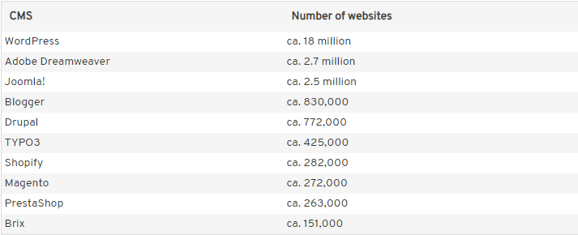
Personal Blog
根據調查在2019年全世界約有18 million網站利用wordpress架設
https://www.ionos.com/digitalguide/hosting/cms/cms-comparison-a-review-of-the-best-platforms/?fbclid=IwAR29ecu8ISPnFT-dmKw6kABKJZgZYc3OIt-MnTlAsvTQPyI1PxpGCsYOxro

Slide 3
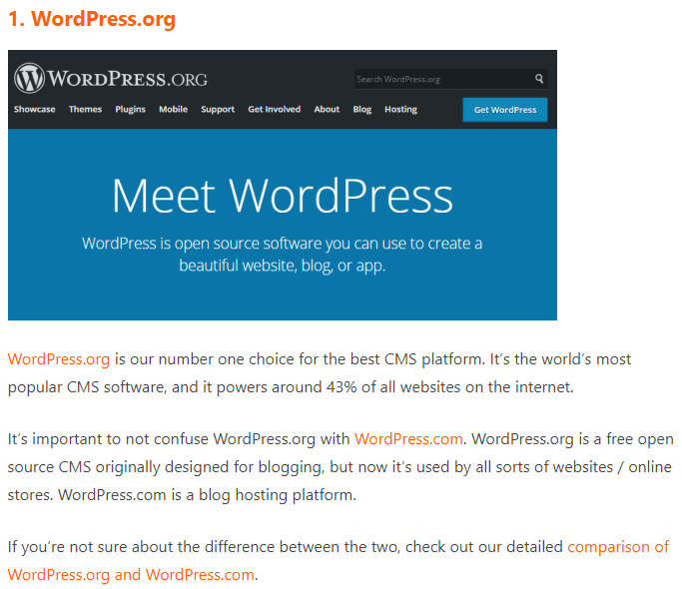
Personal Blog
15 Best and Most Popular CMS Platforms in 2022
wordpress排名第一
https://www.wpbeginner.com/showcase/best-cms-platforms-compared/

Slide 4
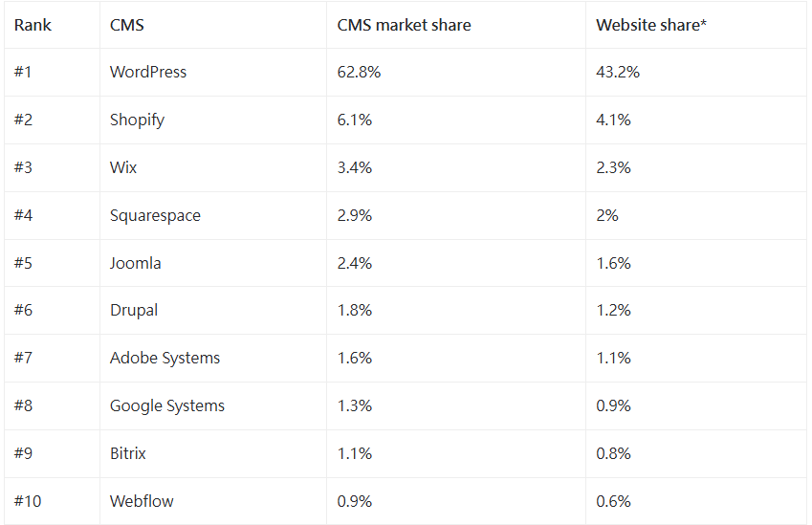
wordpress
根據調查在2025年全世界約有43.2%的網站利用wordpress架設
https://colorlib.com/wp/cms-market-share/

Slide 5
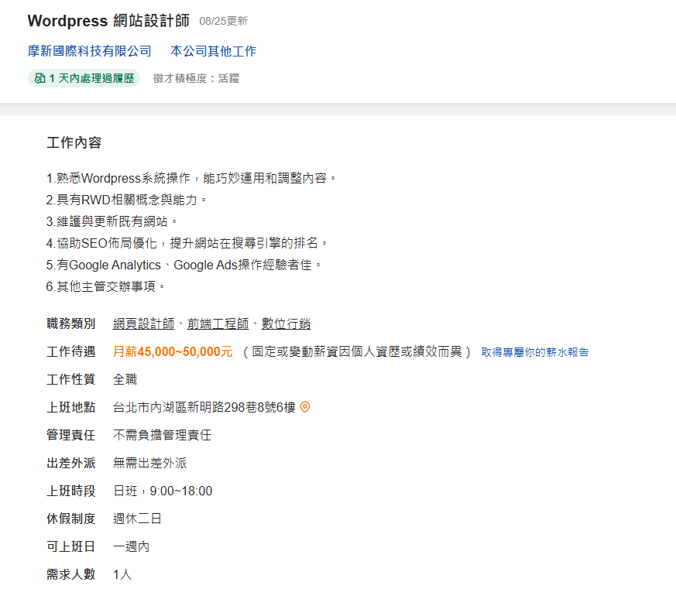
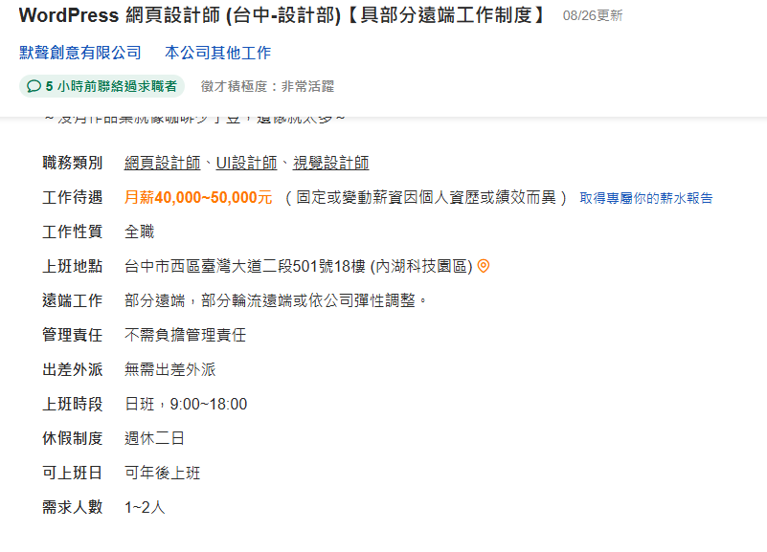
工作機會
https://www.104.com.tw/job/8flu9?jobsource=joblist_search
https://www.104.com.tw/job/8l2oe?jobsource=joblist_search

Slide 6
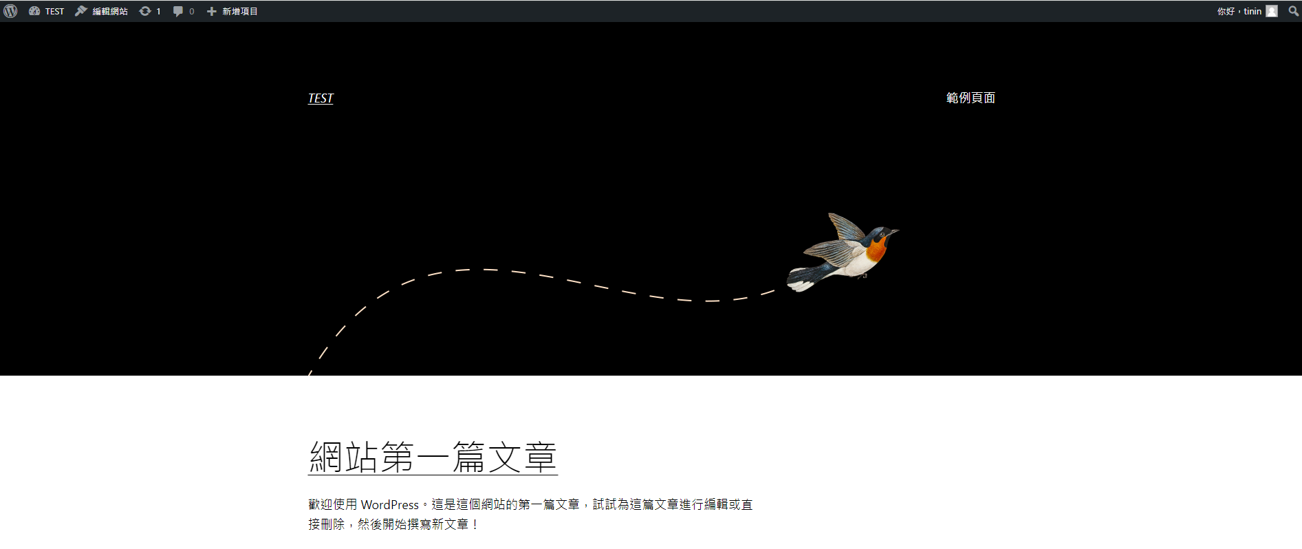
Personal Blog
請利用 WordPress 架設個人Blog
https://tw.wordpress.org/
自行架設 web server

Slide 7
Personal Blog
Install server 40%
apache 10%
Error page 10%
php 5 %
upgrade to php 8.3 10%
MySQL 5%
Install WordPress 30%
Install WordPress 10%
Change WordPress template 10%
更新外觀
Add gallery (plugin) 10%
增加相簿功能
Scan website 10%
Post 2 articles on the Blog 20%
Self-introduction
Any suggestion about this class

Slide 8
Bonus
Register hostname (DNS) +10
https protocol +10
9/18前繳交且原始分數達90分 +10

Slide 9
Deadline
Deadline
10/09 23:59
繳交方式
Demo server
請跟助教約時間
Word檔上傳到portal
檔名：s學號_HW1.doc 或 s學號_HW1.docx
內容包含：網址、網站首頁截圖、自我介紹(純文字)、課程建議(純文字)
檔名未依格式扣10%

Slide 10


Slide 11
Q&A

